Slide 1
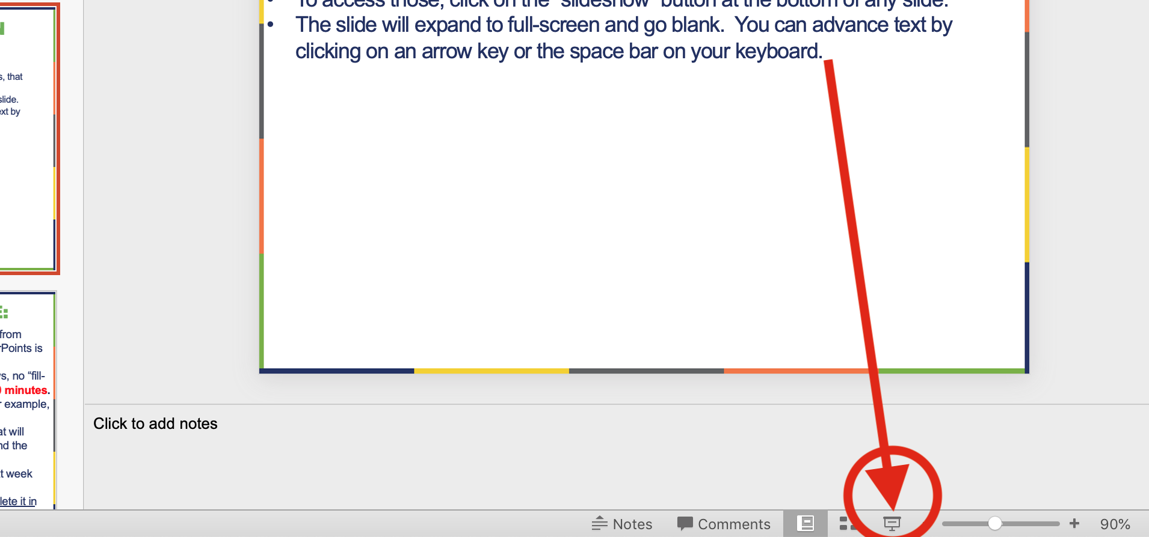
How to access embedded links in Powerpoint slides
Any time you see underlined blue text in class PowerPoints, that means a link to sources or a video.
To access those links, click on the ”slideshow” button at the bottom of any slide.
The slide will expand to full-screen and go blank. You can advance text by clicking the mouse, or by pressing on an arrow key or the space bar.
Click on the underlined blue text to open links in a new browser.
You can exit the slideshow at any time by pressing the Escape (esc) key.

Slide 2

Greetings from Washington DC!

Slide 3

2024 US Election Results
Thoughts on Trump’s overblown mandate.
From Debito Arudou, Ph.D.

Slide 4
Analysis: A clear mandate?
Now that the data is finally in and all Congressional seats have been called, it’s time to make some interpretations.
The first weeks afterwards were GOP triumphalist, with the Presidency and both chambers of Congress in GOP hands. (With the 6-3 conservative supermajority in SCOTUS, that means all three branches of the US Govt are in conservative hands.)
“The American people have re-elected President Trump with an overwhelming mandate to Make America Great Again." -- Steven Cheung, Trump Press Spokesman, Nov 12 [all emphases are Prof. Beamer’s]
“Donald Trump’s overwhelming mandate is a wake-up call for progressive parties who have lost touch with voters’ concerns." -- The Observer (UK), Editorial, Nov. 9.
“Last week Americans gave Republicans an overwhelming mandate to fix everything the Democrats broke. We're already making plans.” Rep Steve Scalise (R-LA) (Nov 12)
“President Trump won by a massive margin with a historic mandate & he deserves the Cabinet he desires to govern.” -- Vivek Ramaswami on Twitter (Dec 7)

Slide 5
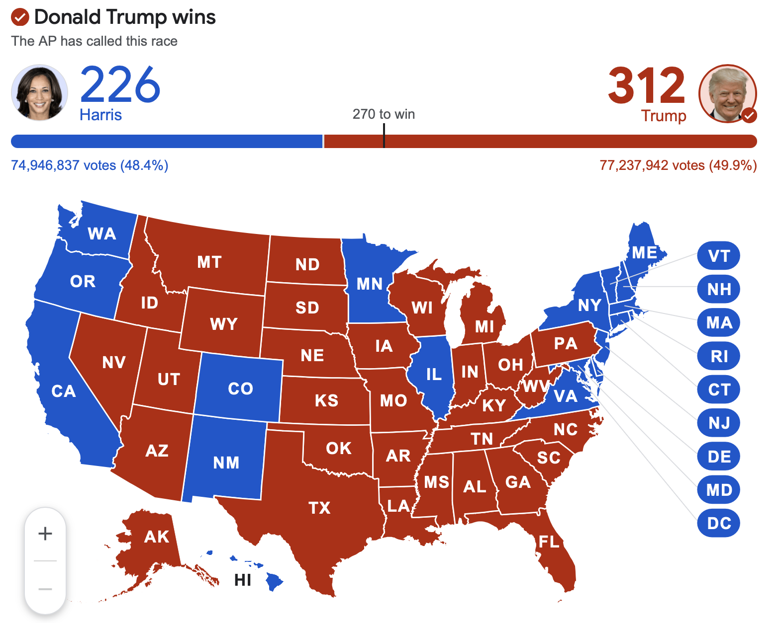
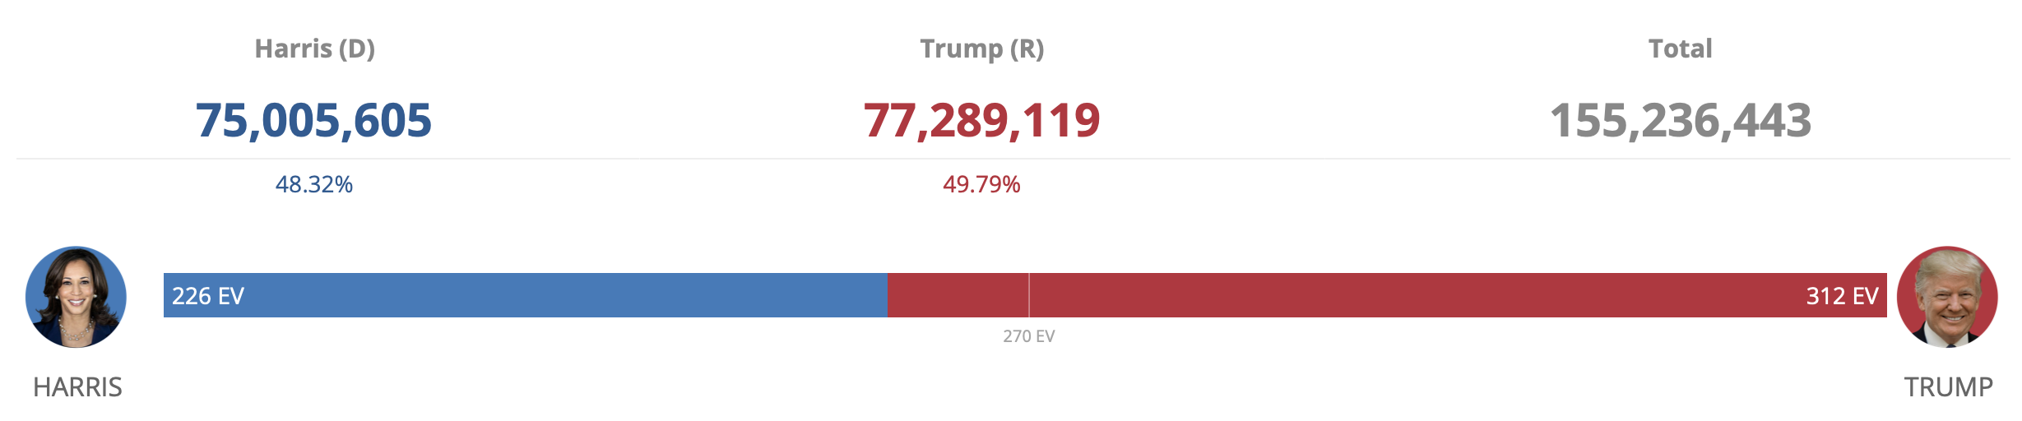
Upfront: The 2024 Election Results
You’ve no doubt heard that the GOP did well in the elections last month.
Trump clearly beat Harris in the Electoral College (Source: AP)
Trump also won a plurality in the popular vote: 77.2 mil votes to 75 mil votes, a nearly 2.3 mil vote difference (Source: Cook Political Report)

Slide 6
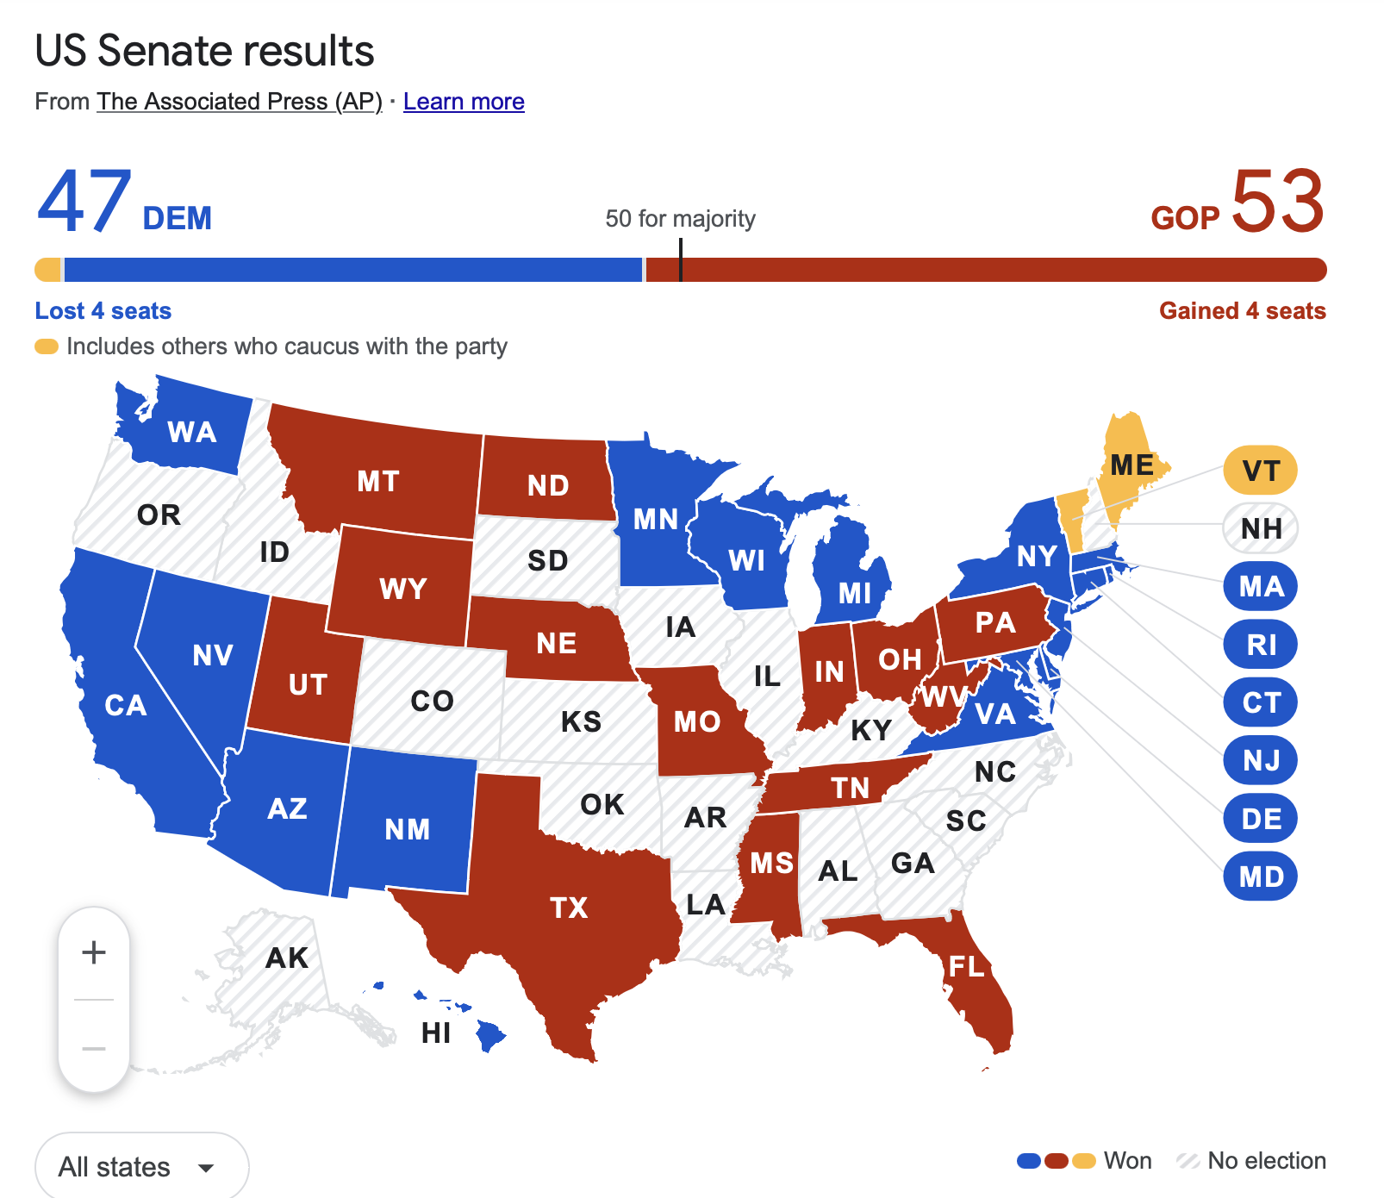
Downballot: The Senate Results
As you can see, the balance of the Senate shifted from 51 Dem-49 GOP to 47-53.
The Dems lost 4 seats, a significant loss, and the GOP now has a majority.
Note it’s not a Filibuster-proof majority (req. 60 seats).
But this makes confirming POTUS nominations easier for Trump 47, and puts GOP in charge of all policy committees.
(Only a third of the Senate is up for election every 2 years, so states without elections in white)

Slide 7
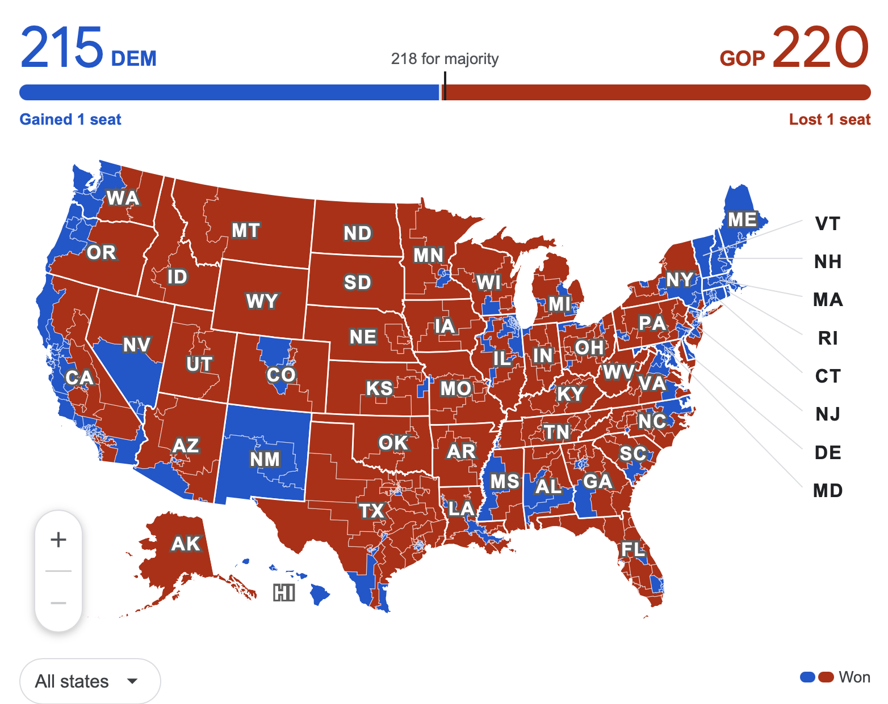
Downballot 2: The House of Reps Results
The GOP won there too.
It keeps its House majority.
Note that it’s a very slender majority. Must have near-unanimity. Three GOP rep defections and policies won’t pass.
And the GOP in fact lost one seat from 2022 elections.
But as a visual, this map looks very red. We’ll get to that later.

Slide 8
Analysis: A clear mandate?
Given that a “mandate” means “the authority to carry out a policy or course of action, regarded as given by the electorate to a candidate or party that is victorious in an election” (Oxford Dict.), this election is being interpreted as giving Trump and the GOP a free hand to remake the US into MAGA America.
It’s apparently what The People want. They’re arguing that voters handed Trump a “massive” and “overwhelming” win in the election.
Really? Let’s look at some fine print here:

Slide 9
Did Trump have an “overwhelming” win? No.
Yes, Trump got more votes than Harris. But in terms of % of the vote, he did not get a majority (more than 50%). He got a plurality: 49.79% of the vote. It’s a win, but arguably not “massive” or “overwhelming”.
Yes, he did much better in the Electoral College (312 to 226), but as we studied this semester, the EC skews things, and has even handed elections to the person who did NOT get the most votes in the election (e.g., Trump-Clinton in 2016), especially if they’re GOP.
In 2016, Clinton won the popular vote, but didn’t take enough states. So the EC is not a reliable gauge of a popular mandate. And consider this:

Slide 10
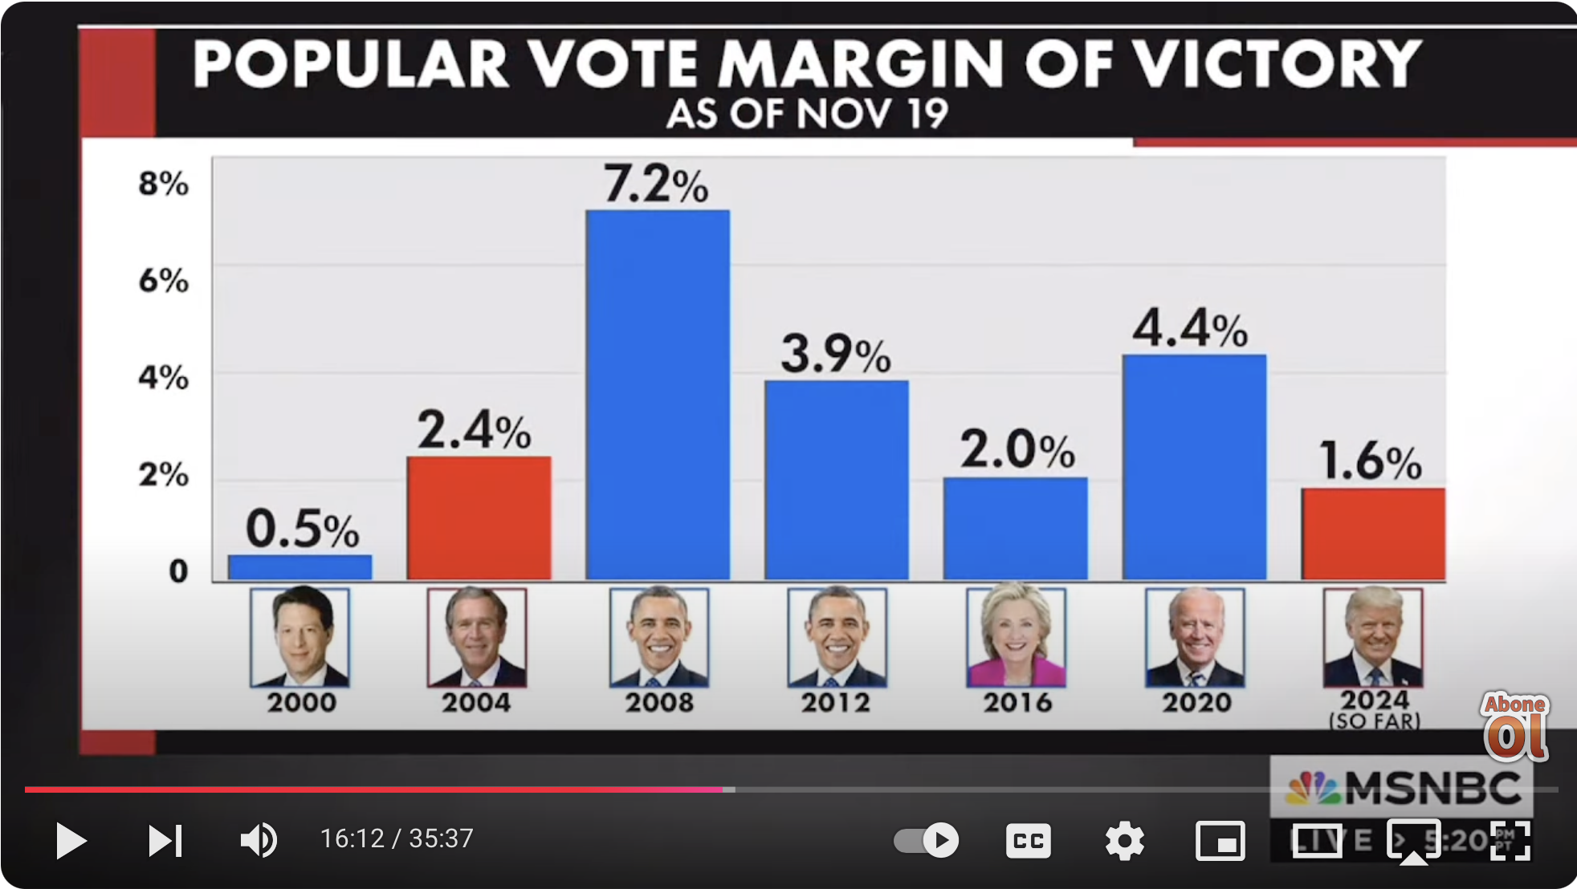
Hillary won by a wider margin in 2016 than Trump did in 2024
If we’re looking at popular vote margins, in 2016 Hillary Clinton beat Trump by more votes than Trump than Trump beat Harris in 2024. (Source: MSNBC, Chris Hayes, Nov 19)
Yet in Clinton’s case, the EC handed the election to Trump.
(And in Harris’s case, despite the lower margin, the EC handed the election to Trump again.)
This demonstrates that the EC offers an ingrained advantage for the GOP (as it did when it handed the 2000 election to GW Bush over popular vote winner Gore).
Yet the EC, not the popular vote, somehow remains the standard for choosing POTUS.

Slide 11
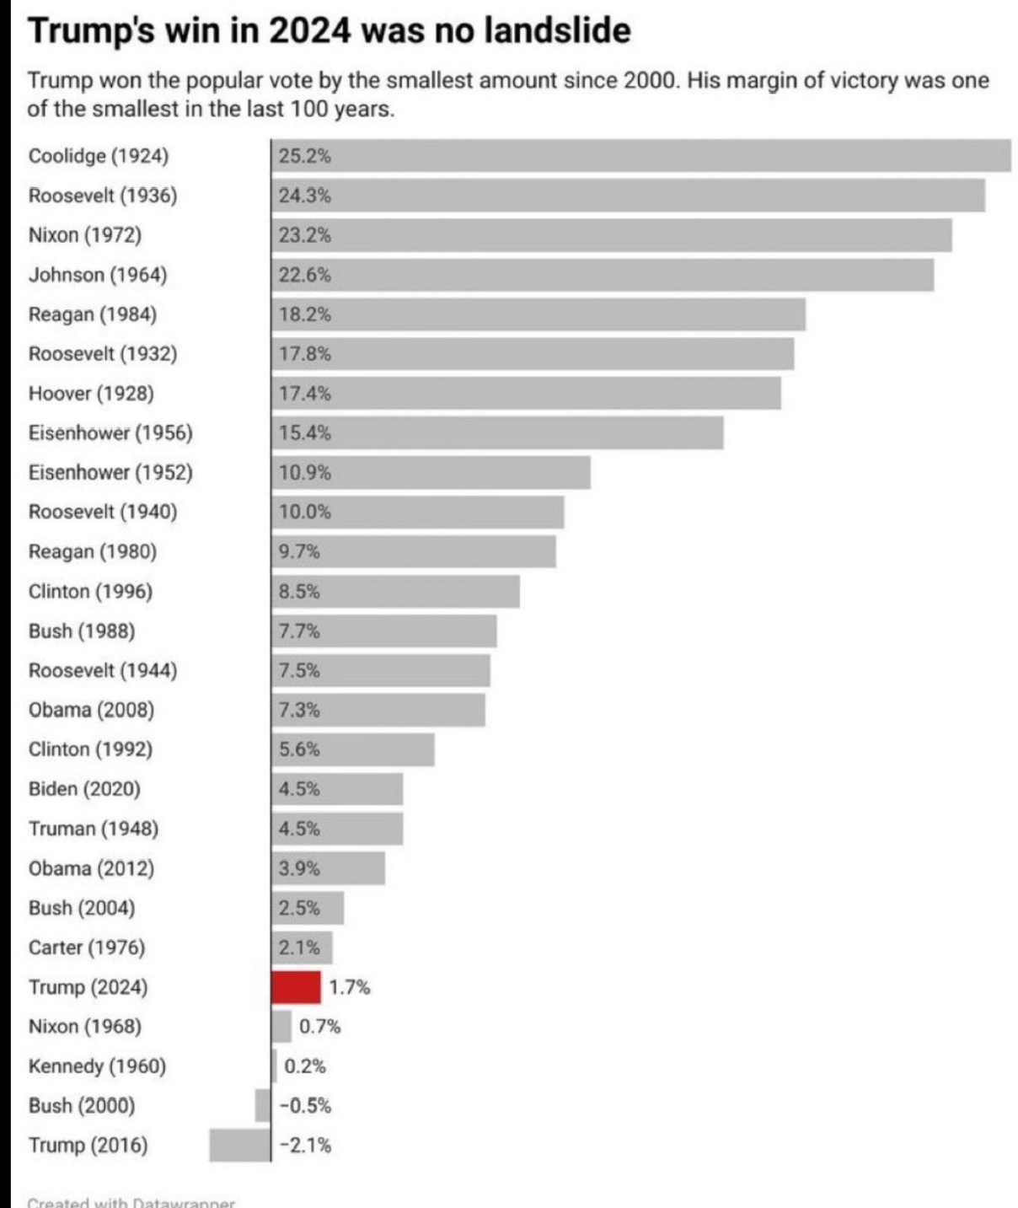
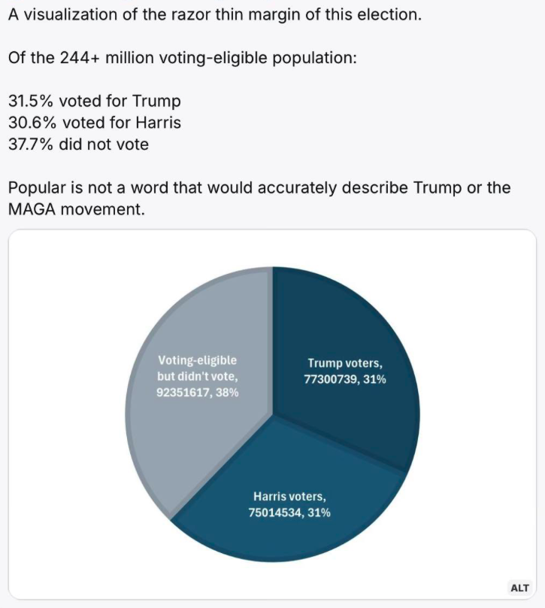
Source: Sen Sheldon Whitehouse
Source: Ian Carillo, Ph.D.

Slide 12
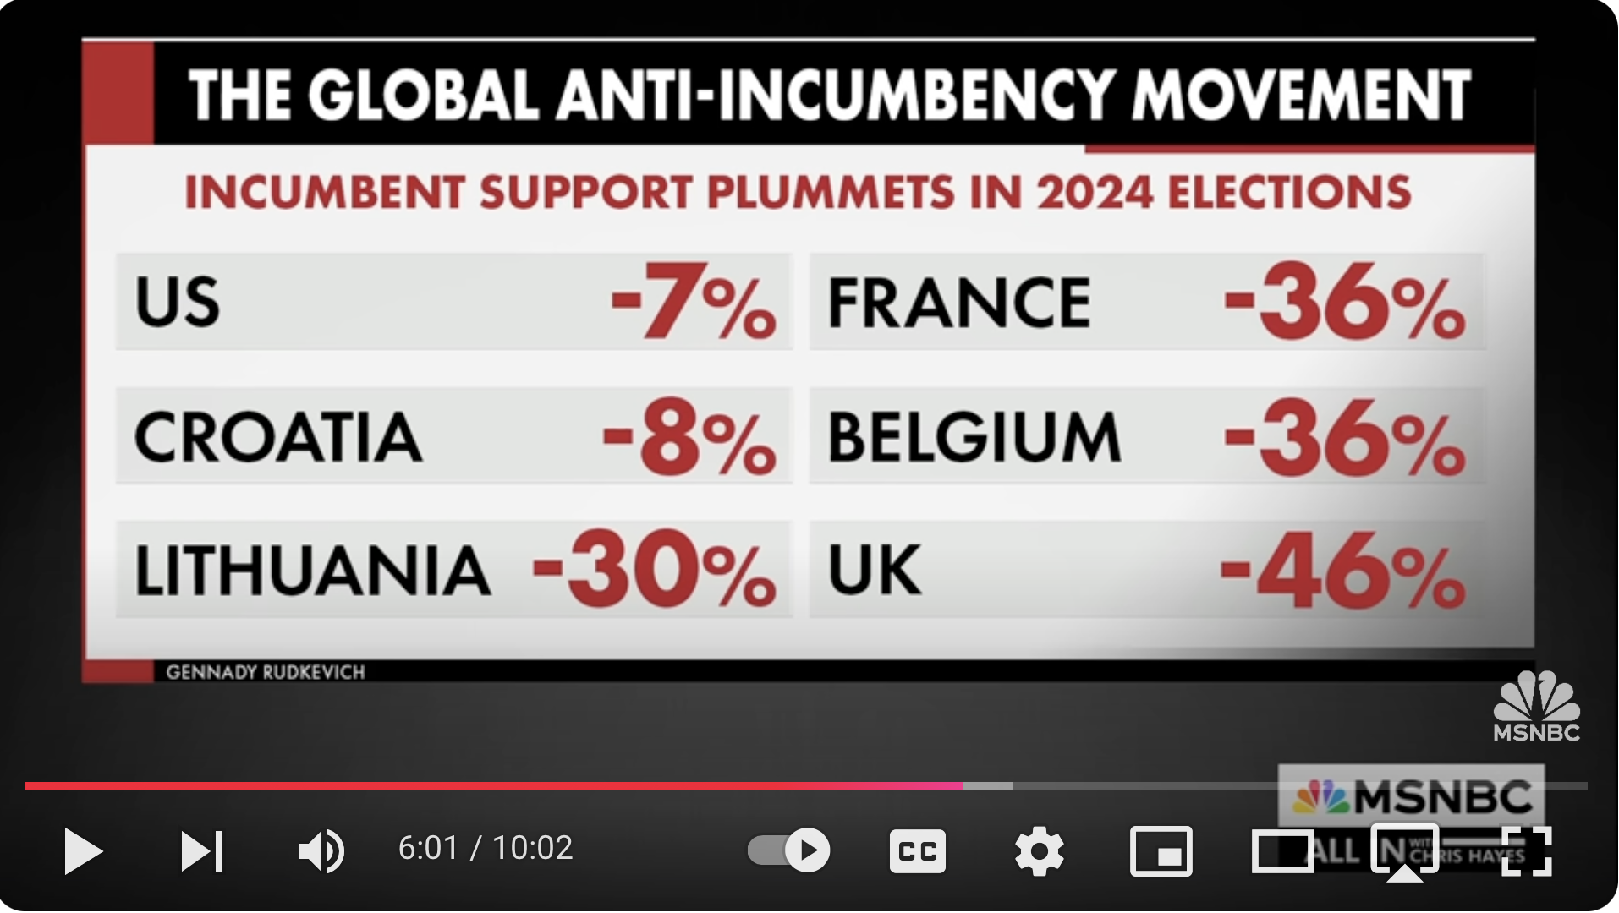
A counter theory: The US is a 50-50 country. Slight vote shifts matter
Like it or not, the US is split pretty much evenly half Left, half Right.
What states those Lefties and Righties are concentrated in determines the EC outcome.
If a few thousands of people in the swing states shift one way or another, things could flip completely due to the EC.
But what happened is a global wave against the current people in office: The “incumbents”.
As per this graphic (Source: MSNBC, Nov. 7, 2024), there were shifts in other countries against the incumbents. Even overwhelmingly against the UK conservatives!
(-46%, meaning nearly half the Conservative Party lost their seats!)
This is not a Rightward shift. This is an anti-incumbent shift, regardless of Right or Left.

Slide 13
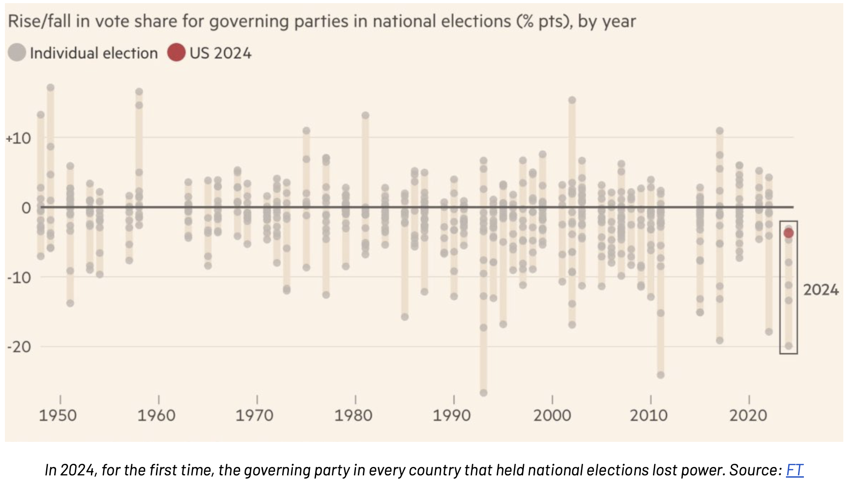
In ALL democracies, the incumbents lost elections in 2024
2024 was the biggest election year in human history. Half of the world’s population (3.7 billion people) voted (UNDP).
Yet in EVERY democracy the incumbents lost (Financial Times, h/t Indivisible pg. 5).
First time since recordkeeping started. Thus this is an anti-incumbent wave worldwide.
But note where the US is on the chart.
US incumbents lost the least (only -7%) of all the democracies surveyed.
So there is no “overwhelming mandate” for the MAGA movement. It’s just spin.
The US Left in fact did better than any other democracy, by losing the least ground.

Slide 14
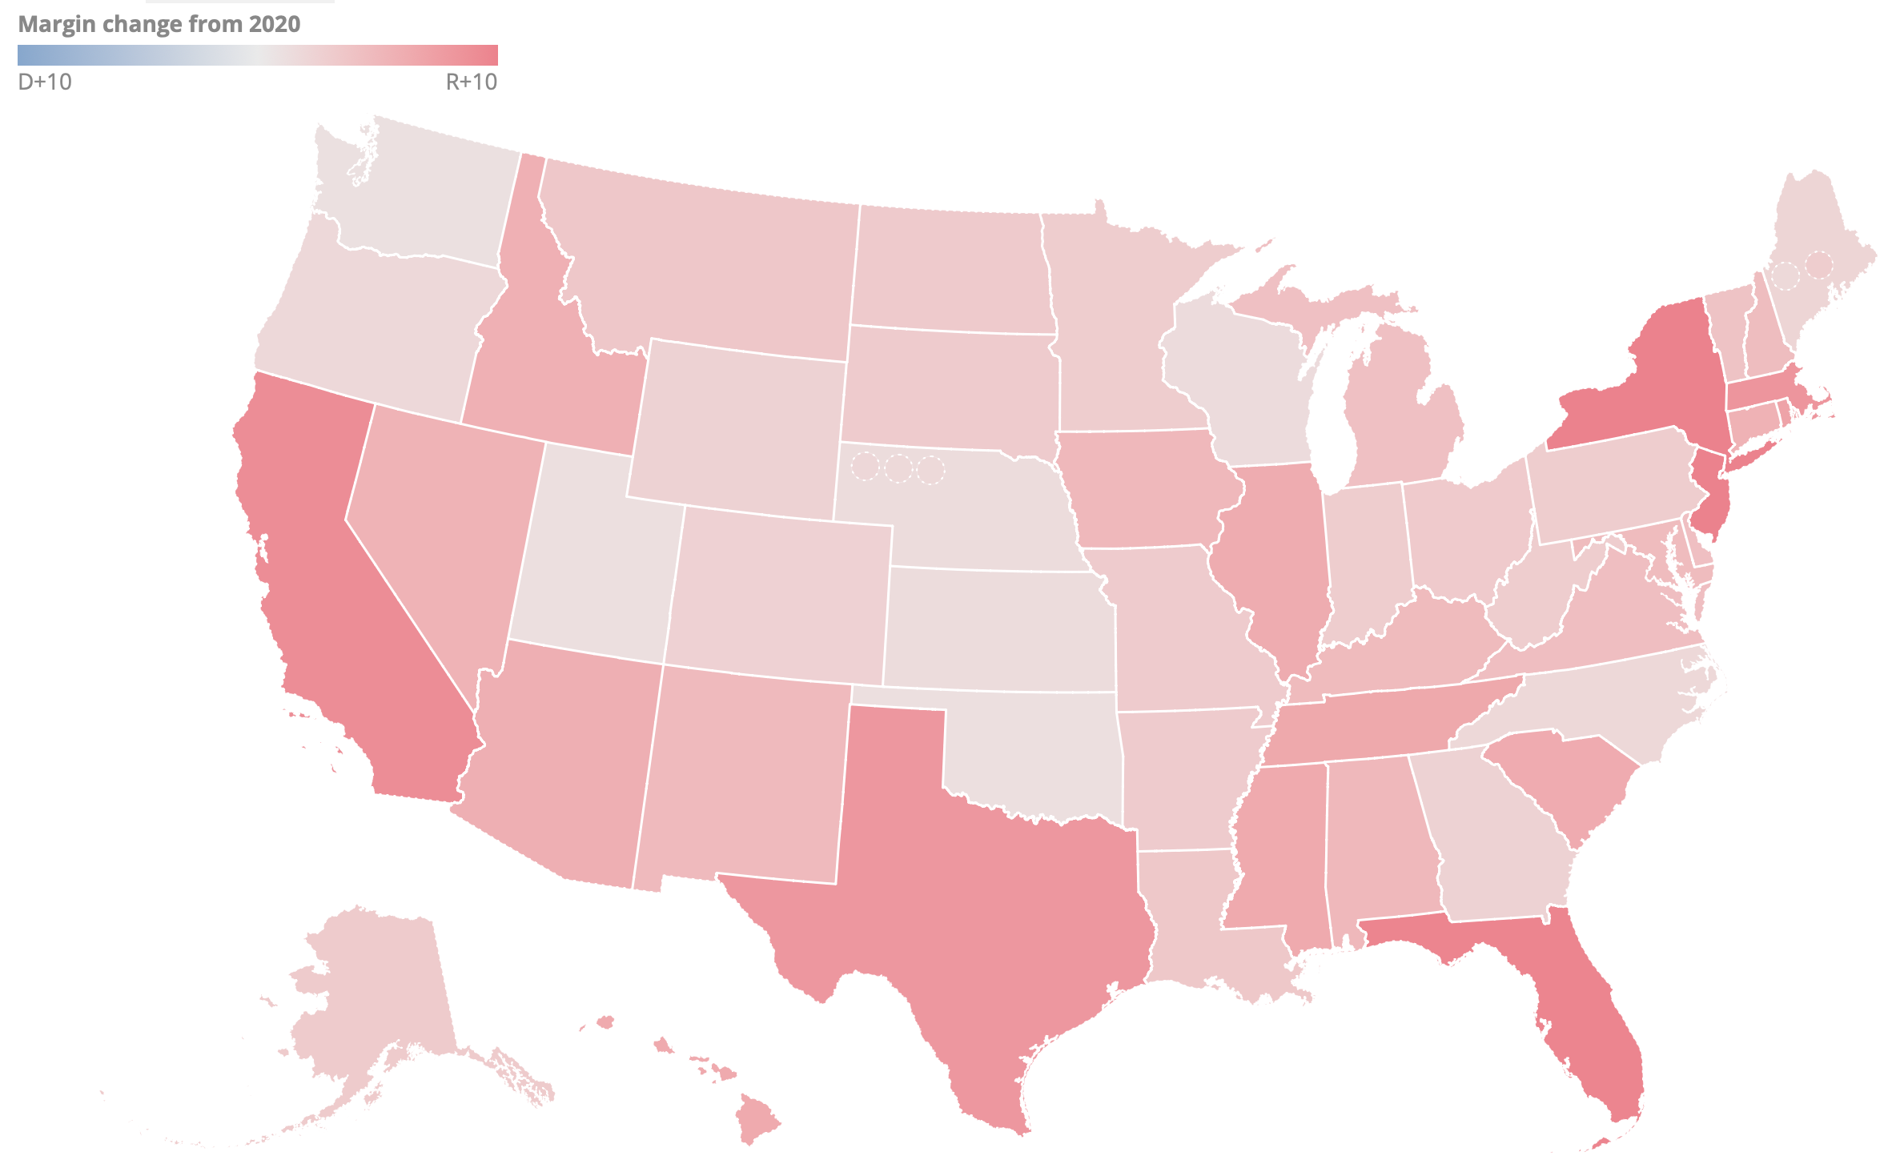
Yes, red shift. An average of only 7%. But 7% will swing whole states in EC.
One thing that is not spin is more people voted for Trump (or voted less for Harris). Everywhere.
Including those who voted for Biden in 2020.
Margin changes (Cook Report) indicate that the biggest shifts were in NY FL TX MA CA.
Why? Incumbent?

Slide 15
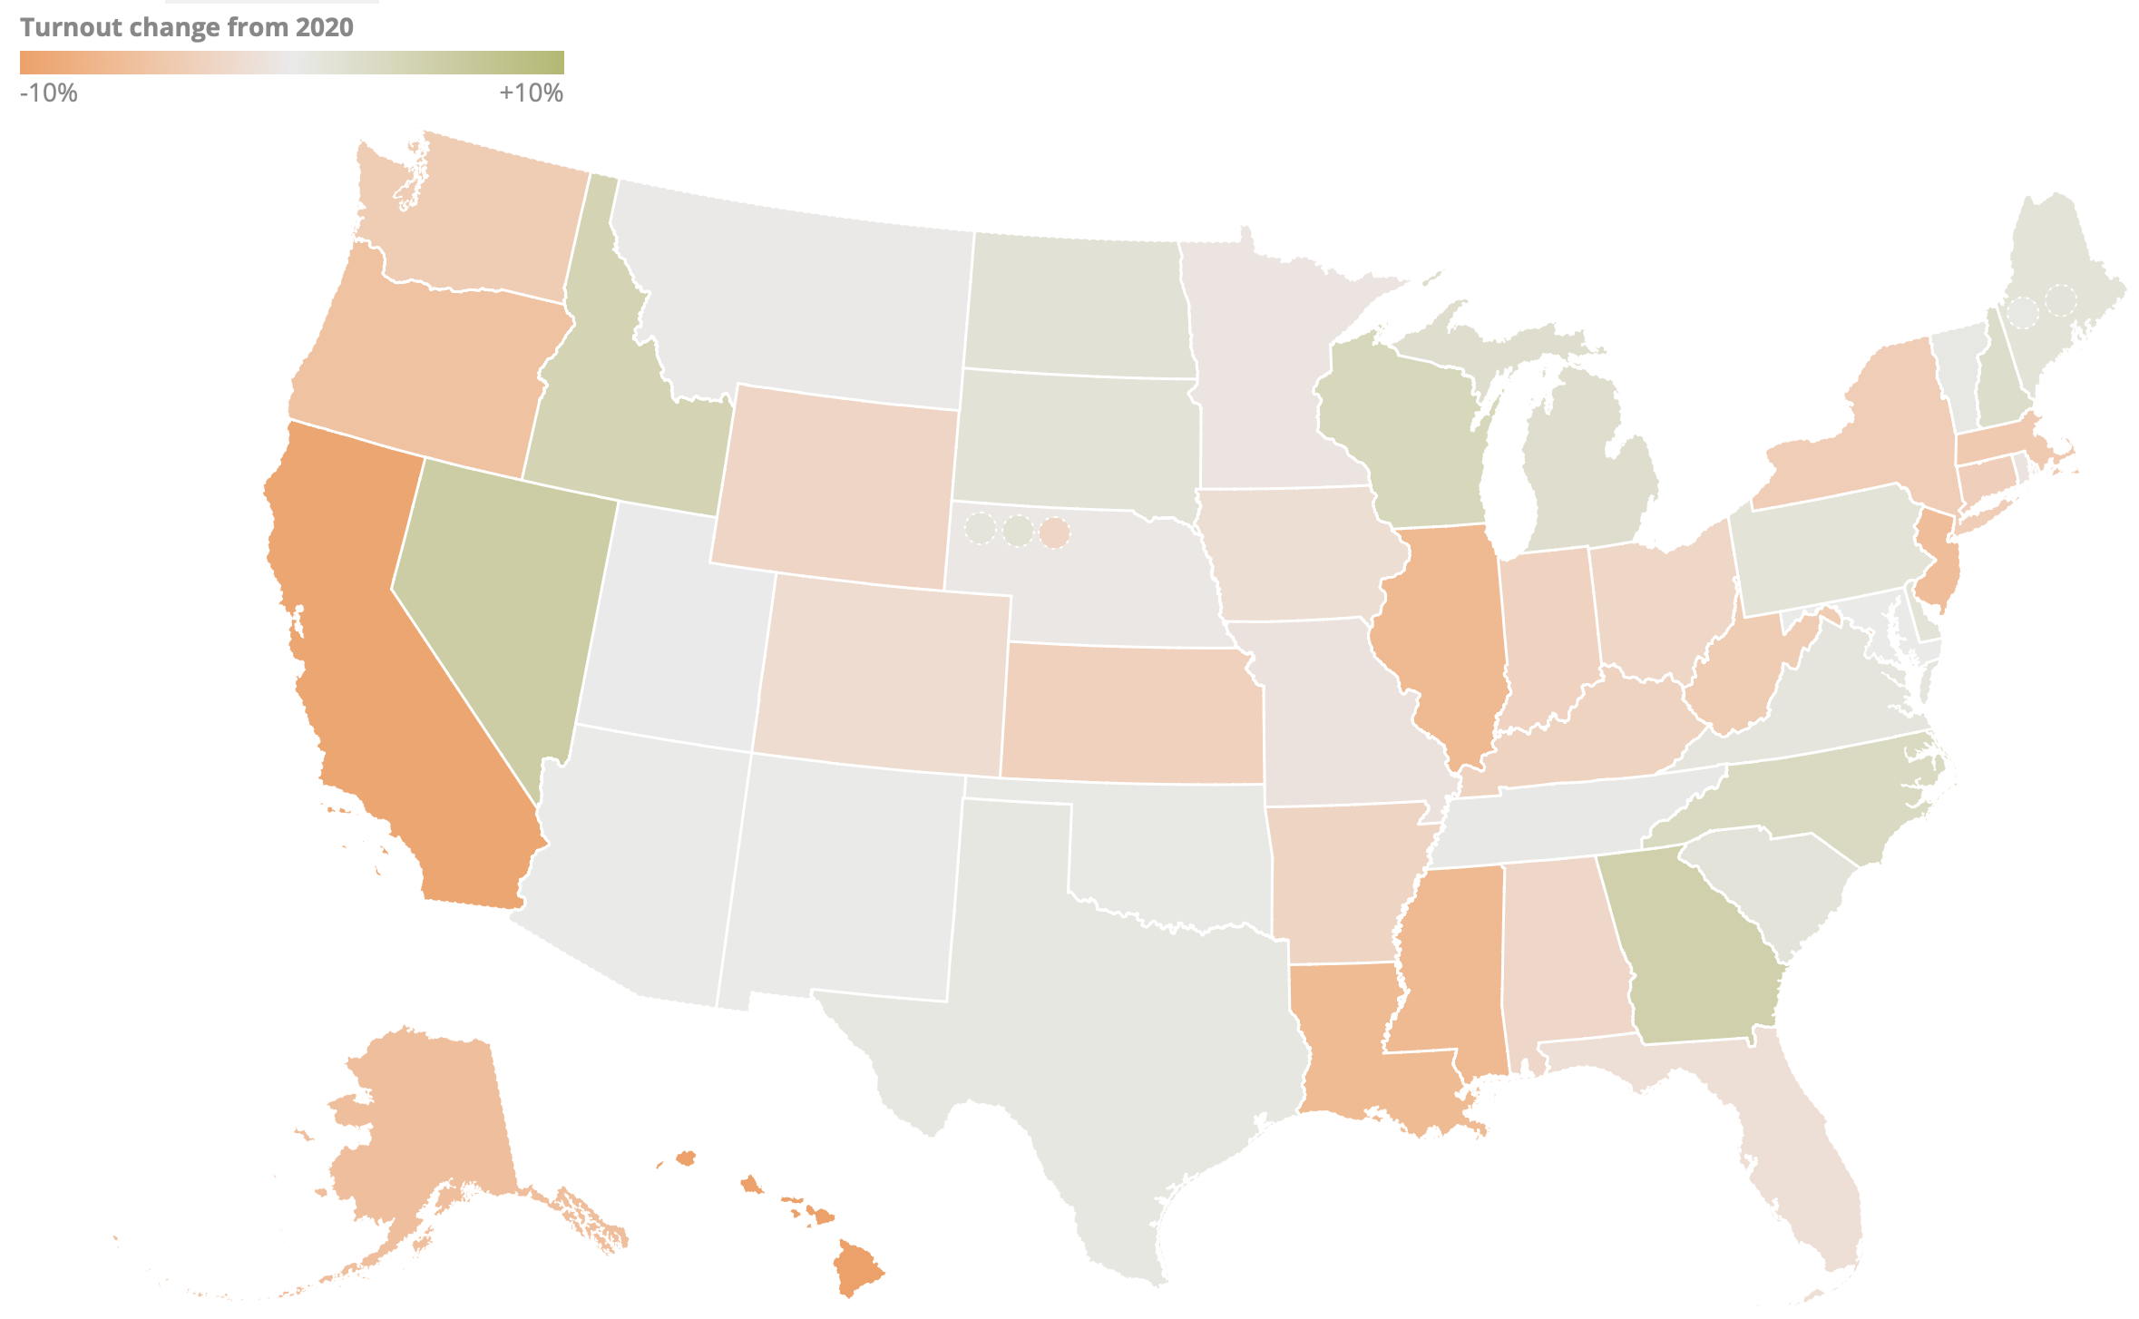
Turnout was down. Except where it counted.
Also, people just voted less. About 3 mil fewer voted in 2024 than in 2020 (155 vs 158 mil).
Except where it mat-tered: Swing states NV GA WI MI NC.
All went Trump => EC.
(Big drops in IL NJ MS LA AK HI. CA voting down 9.4%!)
(Turnout changes Cook Report)

Slide 16
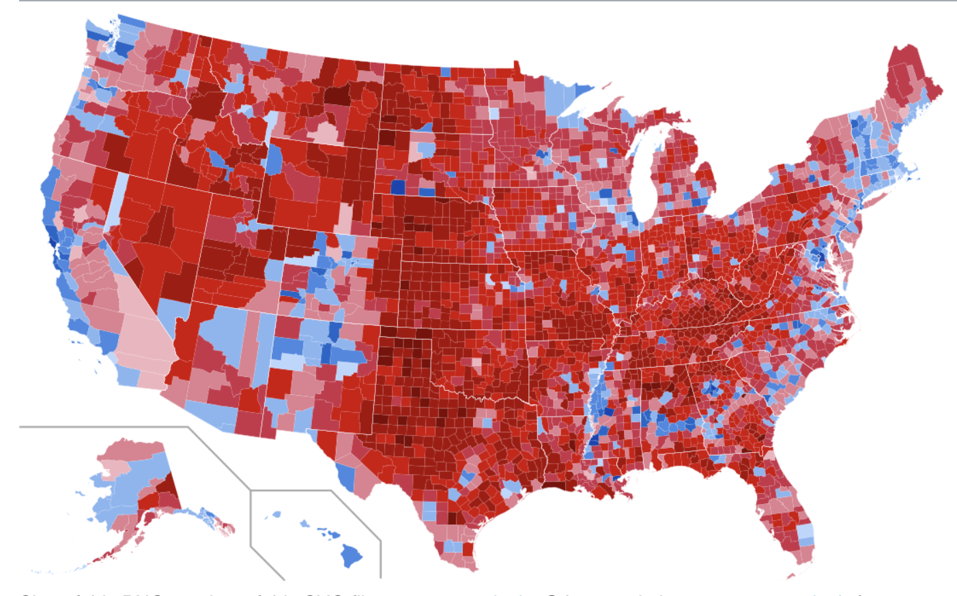
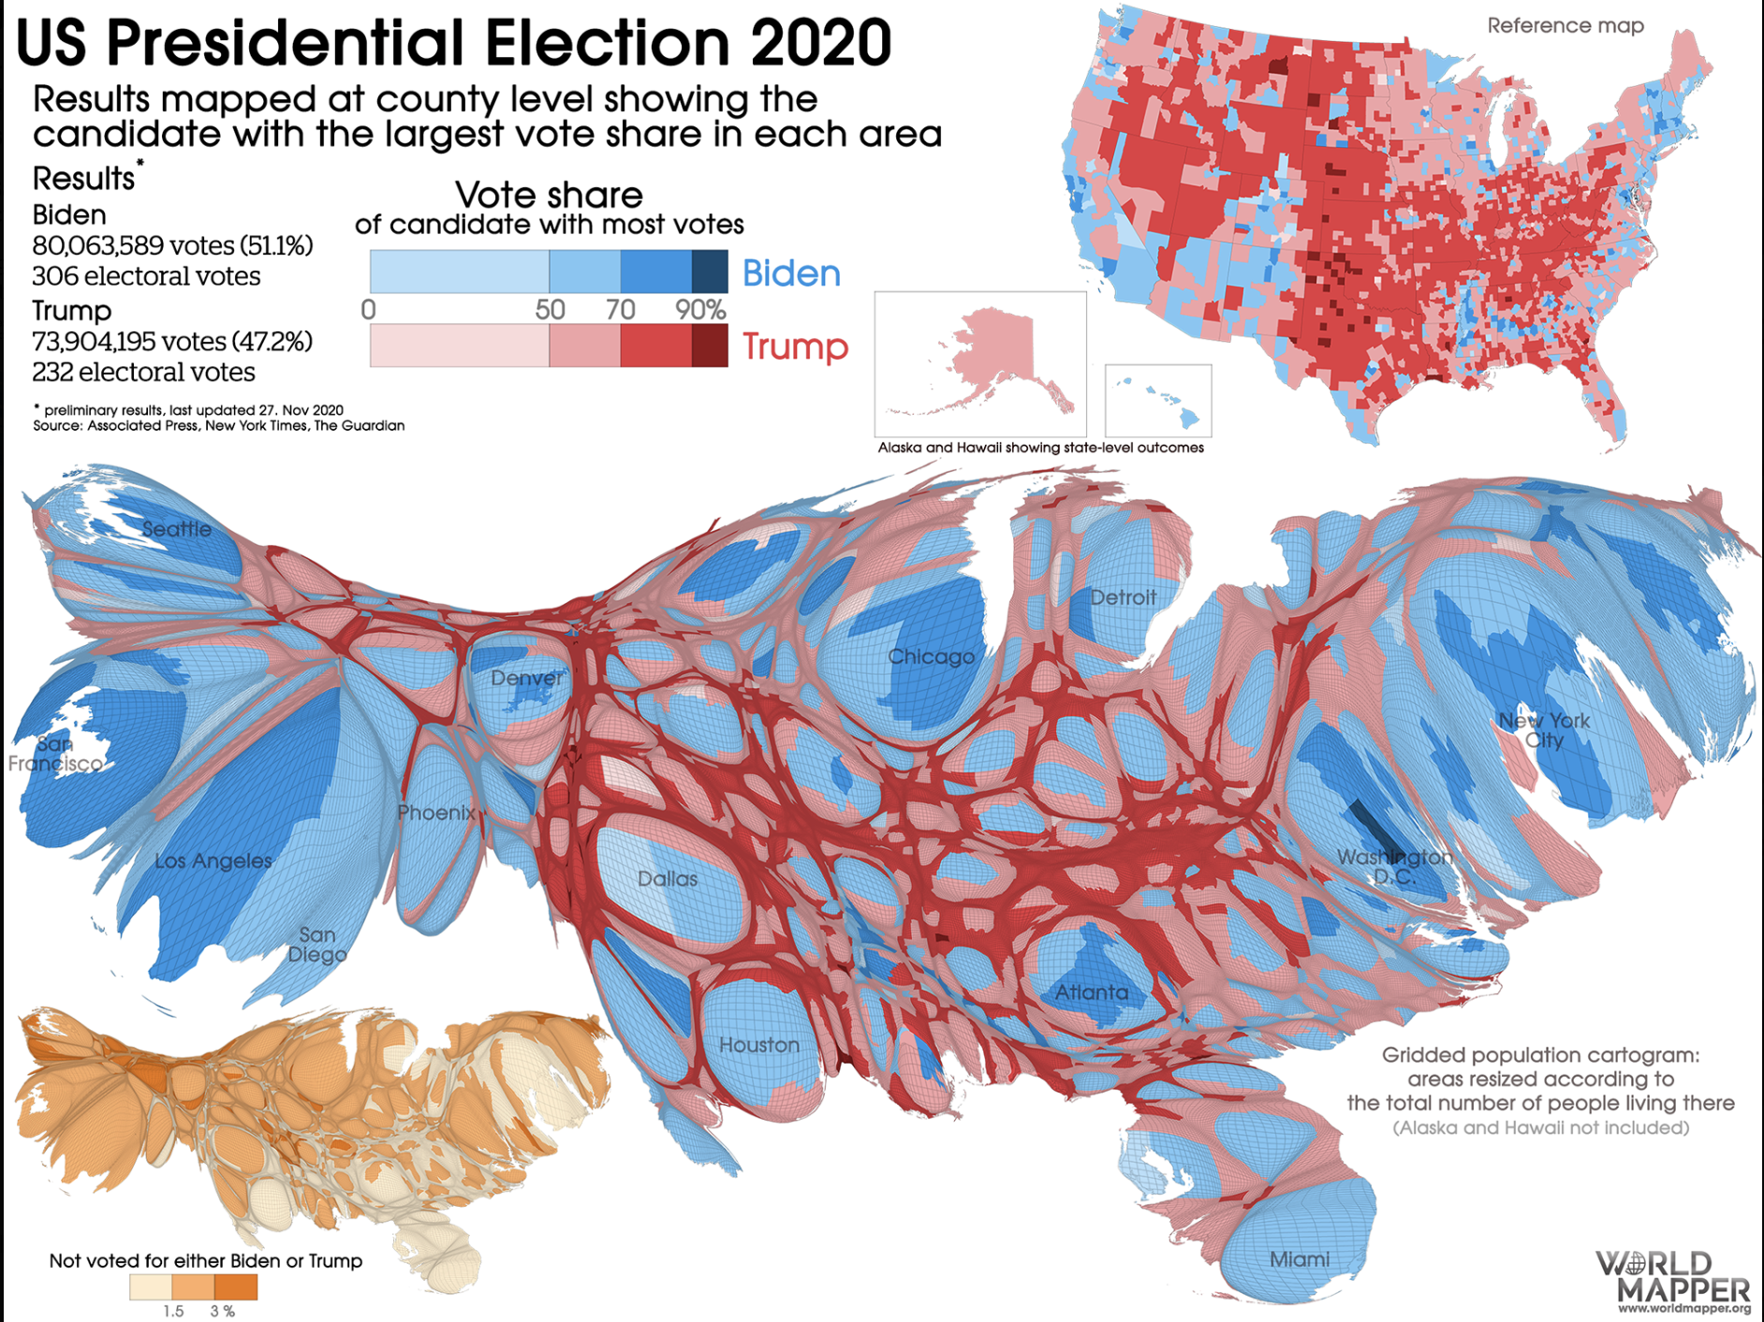
Don’t be fooled by the propaganda. Maps look red, but land doesn’t vote.
Voting by county (2024) Looks pretty red, yes?
Until you weight it by population (2020). Looks much bluer, no?

Slide 17
The point is this:
Trump won. But it was a slender win, and not a majority.
The Senate is firmly GOP, but only by 53-47. Not Filibuster-proof.
The House is slenderly GOP at 220 to 215 seats. But that means the GOP lost one seat from last time (221). And for a few months before special elections replace Trump Cabinet picks from House, it will be 217 to 215.
That’s even more slender a margin, the narrowest since both the Senate & House became popularly elected in 1919. Only one GOP rep has to flip.
So there is no overwhelming mandate for MAGA to do whatever it wants.
America is now a 50-50 country, and this time the global anti-incumbent movement removed the party from office by only 7%.
Not necessarily because they were Dem. But because the Dems were unlucky enough to be the ones in office. But in America, 7% is enough for all swing states to flip and hand the GOP a big-looking EC victory.

Slide 18
I hope you got something out of this presentation!

